Slide 1

Cascading Style Sheet
CSS

Slide 2
Content
Shadow
Text
Transformation
Transition
Animation

Slide 3
CSS Shadow
With CSS shadow can be added to text and to elements.
We will learn two type of shadow effects:
text-shadow
box-shadow

Slide 4
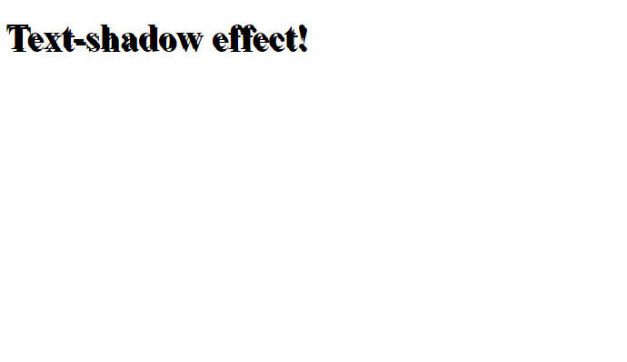
CSS Text Shadow
<!DOCTYPE html> <html> <head> <style>
h1 { text-shadow: 2px 2px; }
</style> </head> <body> <h1>Text-shadow effect!</h1> </body> </html>
The CSS text-shadow property applies shadow to text.
In its simplest use, only specify the horizontal shadow (2px) and the vertical shadow (2px):

Slide 5
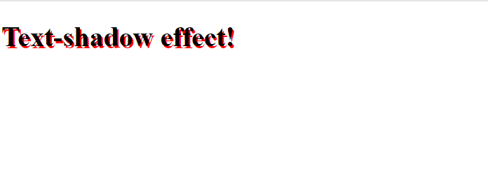
CSS Text Shadow
<!DOCTYPE html> <html> <head> <style>
h1 { text-shadow: 2px 2px red; }
</style> </head> <body> <h1>Text-shadow effect!</h1> </body> </html>
Adding Color to shadow

Slide 6

CSS Text Shadow
<!DOCTYPE html> <html> <head> <style>
h1 { text-shadow: 2px 2px 2px red; }
</style> </head> <body> <h1>Text-shadow effect!</h1> </body> </html>
Adding blur effect and Color to shadow

Slide 7
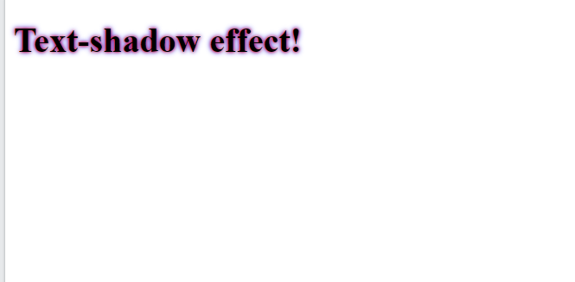
CSS Text Shadow
<!DOCTYPE html> <html> <head> <style>
h1 { text-shadow: 0 0 3px #FF0000, 0 0 5px #0000FF;
}
</style> </head> <body> <h1>Text-shadow effect!</h1> </body> </html>
Multiple Shadows
To add more than one shadow to the text, you can add a comma-separated list of shadows.

Slide 8
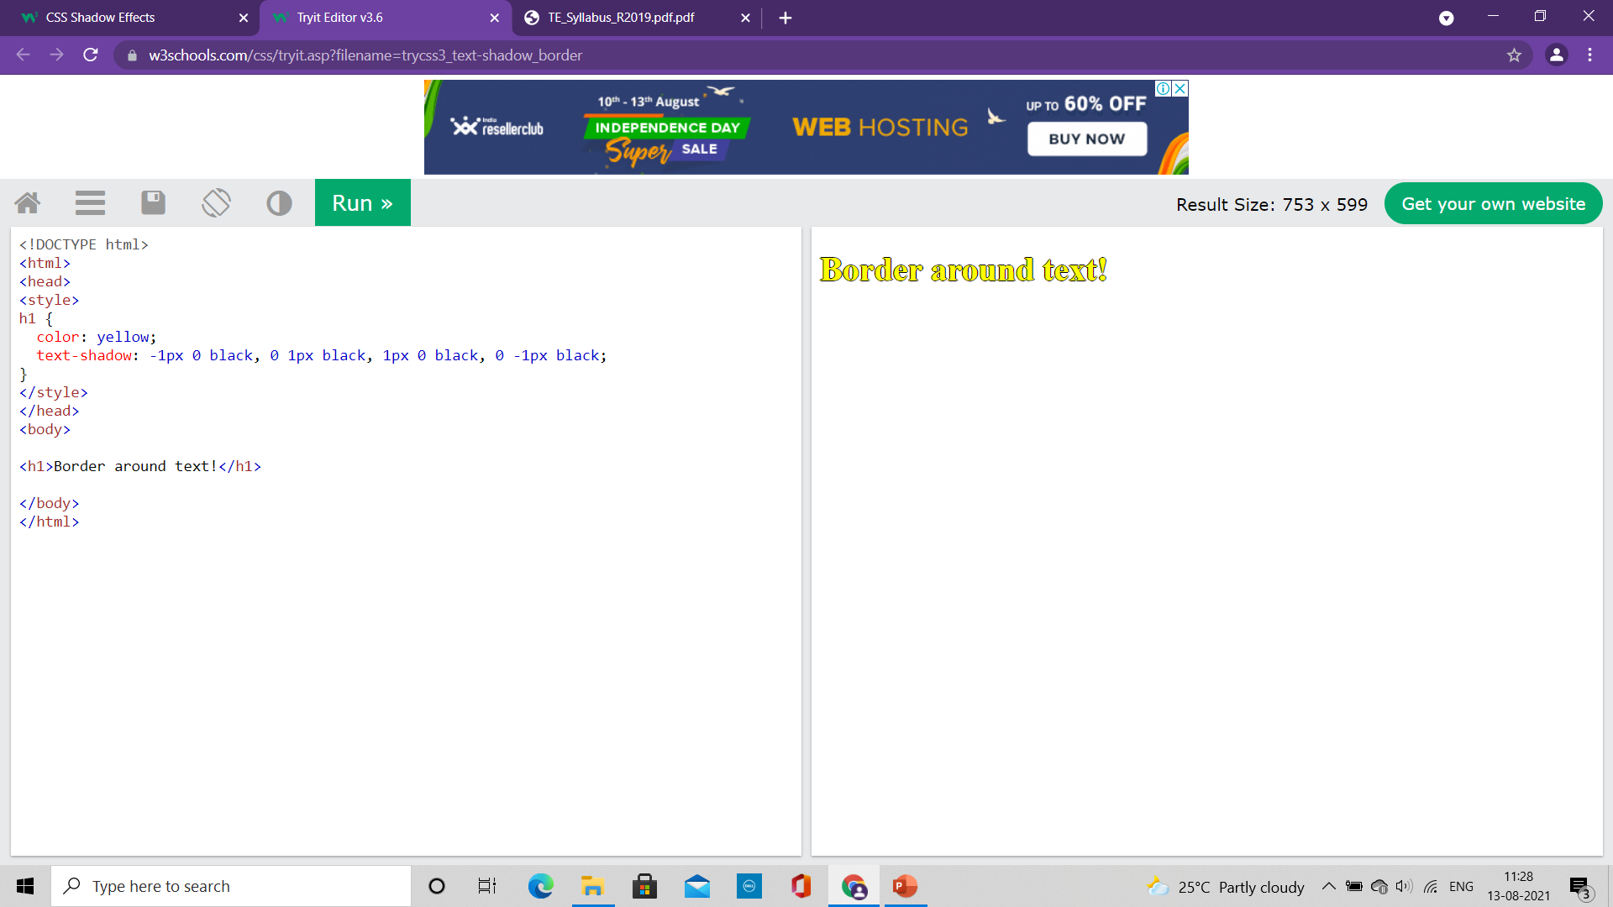
CSS Text Shadow
<!DOCTYPE html> <html> <head> <style>
h1 { color: yellow; text-shadow: -1px 0 black, 0 1px black, 1px 0 black, 0 -1px black;
}
</style> </head> <body> <h1>Text-shadow effect!</h1> </body> </html>
Create plain border using text-shadow property

Slide 9
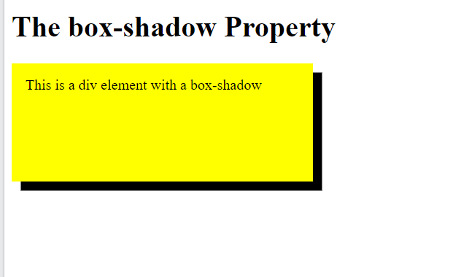
CSS Box Shadow
<!DOCTYPE html>
<html>
<head>
<style>
div {
width: 300px;
height: 100px;
padding: 15px;
background-color: yellow;
box-shadow: 10px 10px;
}
</style>
</head>
<body>
<h1>The box-shadow Property</h1>
<div>This is a div element with a box-shadow</div>
</body>
</html>
The CSS box-shadow property applies shadow to elements.
In its simplest use, you only specify the horizontal shadow and the vertical shadow:

Slide 10
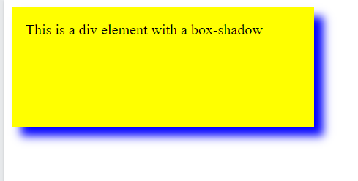
CSS Box Shadow
<!DOCTYPE html>
<html>
<head>
<style>
div {
width: 300px;
height: 100px;
padding: 15px;
background-color: yellow;
box-shadow: 10px 10px 20px blue;
}
</style>
</head>
<body>
<div>This is a div element with a box-shadow</div>
</body>
</html>
Add color and blur effect to shadows

Slide 11
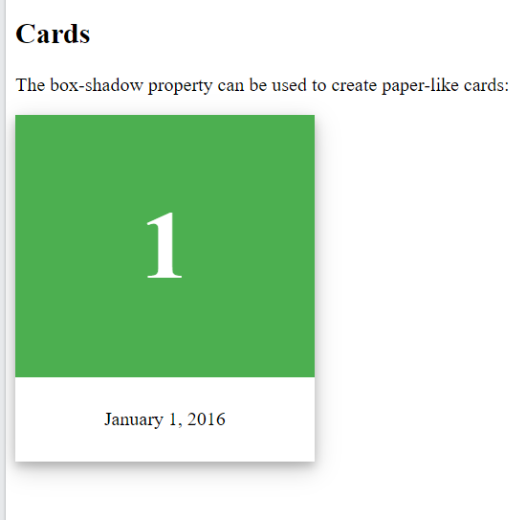
CSS Box Shadow
<!DOCTYPE html>
<html>
<head>
<style>
div.card {
width: 250px;
box-shadow: 0 4px 8px 0 rgba(0, 0, 0, 0.2), 0 6px 20px 0 rgba(0, 0, 0, 0.19);
text-align: center;
}
div.header {
background-color: #4CAF50;
color: white;
padding: 10px;
font-size: 40px;
}
div.container {
padding: 10px;
}
</style>
</head>
<body>
<h2>Cards</h2>
<p>The box-shadow property can be used to create paper-like cards:</p>
<div class="card">
<div class="header">
<h1>1</h1>
</div>
<div class="container">
<p>January 1, 2016</p>
</div>
</div>
</body>
</html>
Box-shadow property can be used to create paper-like cards

Slide 12
CSS Text
CSS has a lot of properties for formatting text.
Color
To specify the color of text: color
To specify the color of background: background-color
Alignment:
The text-align property: set the horizontal alignment of a text
Possible values of text-align property: center, left, right, justify
For justify property, each line is stretched so that every line has equal width, and the left and right margins are straight
The vertical-align property: Sets the vertical alignment of an element
Possible Values: baseline, text-top, text-bottom, sub, super
Decoration
The text-decoration property is used to set or remove decorations from text.
The value text-decoration: none; is often used to remove underlines from links
Possible values are: overline, line-through, underline

Slide 13
CSS Text
CSS has a lot of properties for formatting text.
Transformation
The text-transform property is used to specify uppercase and lowercase letters in a text.
It can be used to turn everything into uppercase or lowercase letters, or capitalize the first letter of each word
Possible values: uppercase, lowercase, capitalize
Spacing
The text-indent property: To specify the indentation of the first line of a text
The letter-spacing property: To specify the space between the characters in a text.
The line-height property: To specify the space between lines
The word-spacing property: To specify the space between the words in a text(Values: wrap/nowrap)
Shadow

Slide 14
CSS 2D Transformation
CSS transforms allow to move, rotate, scale, and skew elements.
The CSS transform property can use the following 2D transformation methods
1. The translate() method
It moves an element from its current position according to the parameters given for the X-axis and the Y-axis
2. The rotate() method
It rotates an element clockwise or counter-clockwise according to a given degree
Using negative values will rotate the element counter-clockwise.
div { transform: translate(50px, 100px); }
div { transform: rotate(20deg); }

Slide 15
CSS 2D Transformation
3. The scale() method
It increases or decreases the size of an element (according to the parameters given for the width and height).
The example increases the <div> element to be two times of its original width, and three times of its original height
4. The scaleX() method
The scaleX() method increases or decreases the width of an element.
5. The scaleY() method
The scaleY() method increases or decreases the height of an element.
div { transform: scale(2, 3); }
div { transform: scaleX(2); }
div { transform: scaleY(2); }

Slide 16
CSS 2D Transformation
6. The skewX() method
It skews an element along the X-axis by the given angle.
7. The skewY() method
It skews an element along the Y-axis by the given angle.
8. The skew() method
The skew() method skews an element along the X and Y-axis by the given angles.
div { transform: skewX(20deg); }
div { transform: skewY(20deg); }
div { transform: skew(20deg, 10deg); }

Slide 17
CSS 3D Transformation
The CSS transform property you can use the following 3D transformation methods:
rotateX(): rotates an element around its X-axis at a given degree
rotateY(): rotates an element around its Y-axis at a given degree
rotateZ(): rotates an element around its Z-axis at a given degree
div { transform: rotateX(20deg); }
div { transform: rotateY(20deg); }
div { transform: rotateZ(20deg); }

Slide 18
CSS Transition
CSS transitions allows you to change property values smoothly, over a given duration.
To create a transition effect, you must specify two things:
The CSS property you want to add an effect to
The duration of the effect
If the duration part is not specified, the transition will have no effect, because the default value is 0.
Example:
The transition effect will start when the specified CSS property (width) changes value.
specify a new value for the width property when a user mouses over the <div> element
When the cursor mouses out of the element, it will gradually change back to its original style.
div { width: 100px; height: 100px; background: red; transition: width 2s; }
div:hover { width: 300px; }

Slide 19
CSS Transition
Change Several Property Values:
The example adds a transition effect for both the width and height property, with a duration of 2 seconds for the width and 4 seconds for the height:
div { width: 100px; height: 100px; background: red; transition: width 2s height 4s; }

Slide 20
CSS Transition
Speed Curve of Transition
The transition-timing-function property specifies the speed curve of the transition effect.
The transition-timing-function property can have the following values:
ease - specifies a transition effect with a slow start, then fast, then end slowly (this is default)
linear - specifies a transition effect with the same speed from start to end
ease-in - specifies a transition effect with a slow start
ease-out - specifies a transition effect with a slow end
ease-in-out - specifies a transition effect with a slow start and end
cubic-bezier(n,n,n,n) - lets you define your own values in a cubic-bezier function
The transition-delay property specifies a delay (in seconds) for the transition effect.

Slide 21
CSS Animation
An animation lets an element gradually change from one style to another.
You can change as many CSS properties you want, as many times as you want.
To use CSS animation, you must first specify some keyframes for the animation.
Keyframes hold what styles the element will have at certain times.

Slide 22
CSS Animation
/* The animation code */ @keyframes example { from {background-color: red;} to {background-color: yellow;} } /* The element to apply the animation to */ div { width: 100px; height: 100px; background-color: red; animation-name: example; animation-duration: 4s; }
When you specify CSS styles inside the @keyframes rule, the animation will gradually change from the current style to the new style at certain times.
To get an animation to work, you must bind the animation to an element.
The example binds the "example" animation to the <div> element.
The animation will last for 4 seconds, and it will gradually change the background-color of the <div> element from "red" to "yellow":

Slide 23
CSS Animation
/* The animation code */ @keyframes example { from {background-color: red;} to {background-color: yellow;} } /* The element to apply the animation to */ div { width: 100px; height: 100px; background-color: red; animation-name: example; animation-duration: 4s; }
The animation-duration property defines how long an animation should take to complete.
If the animation-duration property is not specified, no animation will occur, because the default value is 0s (0 seconds).
In the example we have specified when the style will change by using the keywords "from" and "to" which represents 0% (start) and 100% (complete)
It is also possible to use percent. By using percent, you can add as many style changes as you like.

Slide 24
CSS Animation
/* The animation code */ @keyframes example { 0% {background-color: red;} 25% {background-color: yellow;} 50% {background-color: blue;} 100% {background-color: green;} } /* The element to apply the animation to */ div { width: 100px; height: 100px; background-color: red; animation-name: example; animation-duration: 4s; }
The example will change the background-color of the <div> element when the animation is 25% complete, 50% complete, and again when the animation is 100% complete:

Slide 25
CSS Animation
Delay in animation
The animation-delay property specifies a delay for the start of an animation.
Negative values are also allowed.
If using negative values, the animation will start as if it had already been playing for N seconds.
Animation Count
The animation-iteration-count property specifies the number of times an animation should run.
div { width: 100px; height: 100px; position: relative; background-color: red; animation-name: example; animation-duration: 4s; animation-delay: 2s;
animation-iteration-count: 3; }

Slide 26
CSS Animation
Run Animation in Reverse Direction or Alternate Cycles
The animation-direction property specifies whether an animation should be played forwards, backwards or in alternate cycles.
The animation-direction property can have the following values:
normal - The animation is played as normal (forwards). This is default
reverse - The animation is played in reverse direction (backwards)
alternate - The animation is played forwards first, then backwards
alternate-reverse - The animation is played backwards first, then forwards

Slide 27
CSS Animation
Speed Curve of the Animation
The animation-timing-function property specifies the speed curve of the animation.
The animation-timing-function property can have the following values:
ease - Specifies an animation with a slow start, then fast, then end slowly (this is default)
linear - Specifies an animation with the same speed from start to end
ease-in - Specifies an animation with a slow start
ease-out - Specifies an animation with a slow end
ease-in-out - Specifies an animation with a slow start and end
cubic-bezier(n,n,n,n) - Lets you define your own values in a cubic-bezier function

Slide 28
CSS Animation
Fill-mode for the Animation
CSS animations do not affect an element before the first keyframe is played or after the last keyframe is played.
The animation-fill-mode property can override this behavior.
The animation-fill-mode property specifies a style for the target element when the animation is not playing before it starts, after it ends, or both
The animation-fill-mode property can have the following values:
none - Default value. Animation will not apply any styles to the element before or after it is executing
forwards - The element will retain the style values that is set by the last keyframe (depends on animation-direction and animation-iteration-count)
backwards - The element will get the style values that is set by the first keyframe (depends on animation-direction), and retain this during the animation-delay period
both - The animation will follow the rules for both forwards and backwards, extending the animation properties in both directions

Slide 29
CSS Animation shorthand property
div {
animation-name: example;
animation-duration: 5s;
animation-timing-function: linear;
animation-delay: 2s;
animation-iteration-count: infinite;
animation-direction: alternate;
}
div {
animation: example 5s linear 2s infinite alternate;
}

